Slide 1

Lecture 11
-NLP is all about words, their arrangement and their meaning
-NLP is a branch of AI that tries to emulate/understand the way a human speaks to another human
-Lecture 11 is about classifiers for text classification

Slide 2
List of classifiers
Distance-based classifiers (Eg. – Manhattan (L1-norm), Euclidean (L2-norm))
Similarity-based classifiers (Eg. - cosine, jaccard)
Decision tree
Random forest of decision trees
Neural networks
Logistic regression
Naïve Bayes (probabilistic)
Support Vector Machines (SVM)

Slide 3
Text classification task
Let v be the feature vector associated with training document d₁
Let w be the feature vector associated with test document d₂
Calculation:
Compute the distance between the two feature vectors
OR
Compute the similarity between the two feature vectors
Given lots of training documents and 1 test document -
Check for minimum distance OR maximum similarity with the test document (CLOSEST MATCH indicates the CLASS of test document)

Slide 4
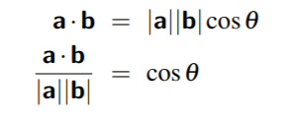
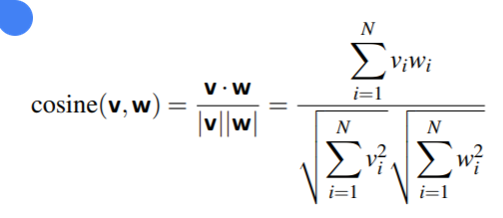
Similarity classifier
Cosine similarity

